Slide 1

Network Flights in Brazil
SMM 638 - Network Analytics
Mid-Term Project
Group 10

Slide 2
Background
Covid-19 pandemic; interest in Brazil flights
Network of flights captures change in structure, distribution, or core airports, etc
Two approaches: Dynamic Geographic Map and nx Graph
Plots reflect network differences before, during and after the pandemic
Two datasets: Kaggle (All flights in Brazil from Jan 19 - Jun 21)
Partow.net (Global Airport Database)

Slide 3
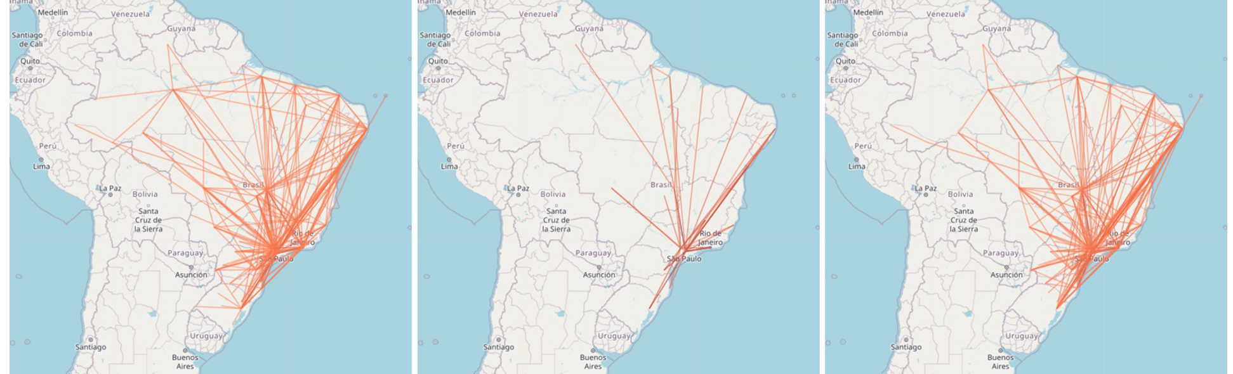
Network Graph
Before, During and After Covid pandemic (From Left to Right)
GIF in compressed folder

Slide 4
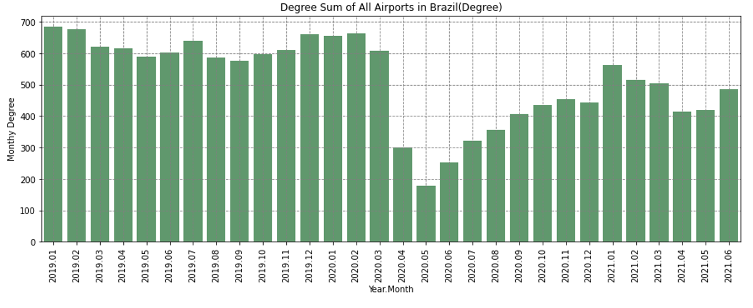
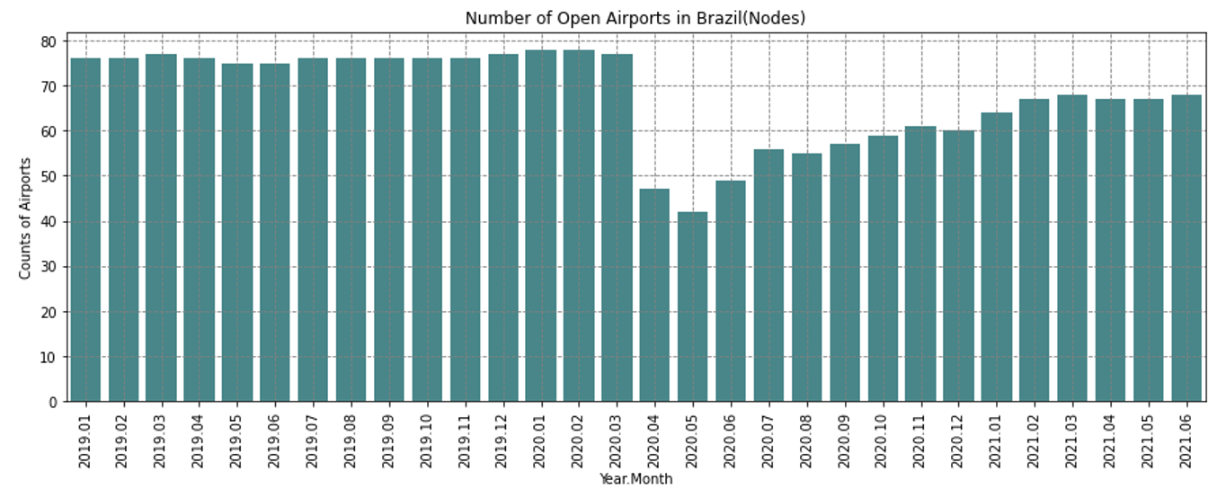
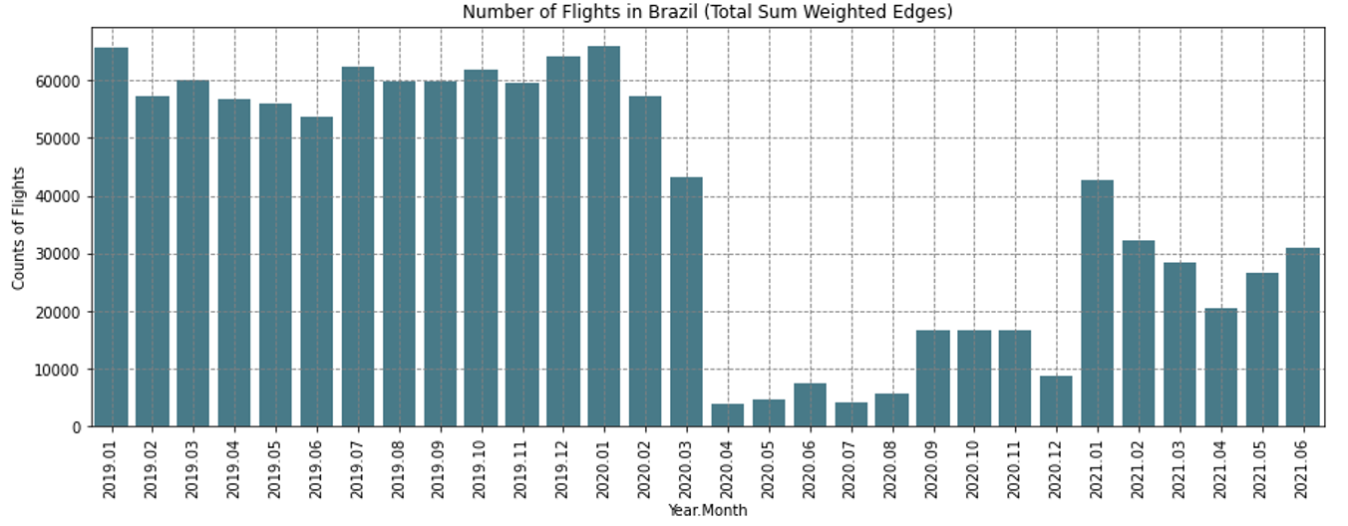
Weighted edges, Nodes and Degree
Edges = flights
Nodes = airports
One Mode = national flights
Total flights, Open Airports, and Flights Types decreased significantly from Apr 20 to Jun 20 ; Recovering period is seen from Jul 20 to Jun 21

Slide 5
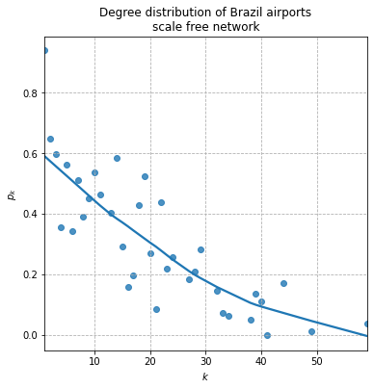
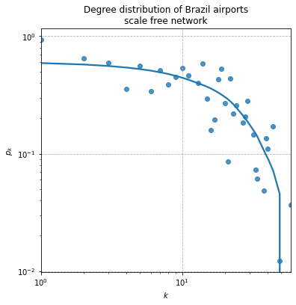
Degree Distribution of the network
Close to a power-law plot following a straight line
Outliers above Pk > 0.6 cause a bit non-linearity
Log-log plot shows probability of observing high-degree core nodes
Network of flights in Brazil is scale-free rather than random

Slide 6
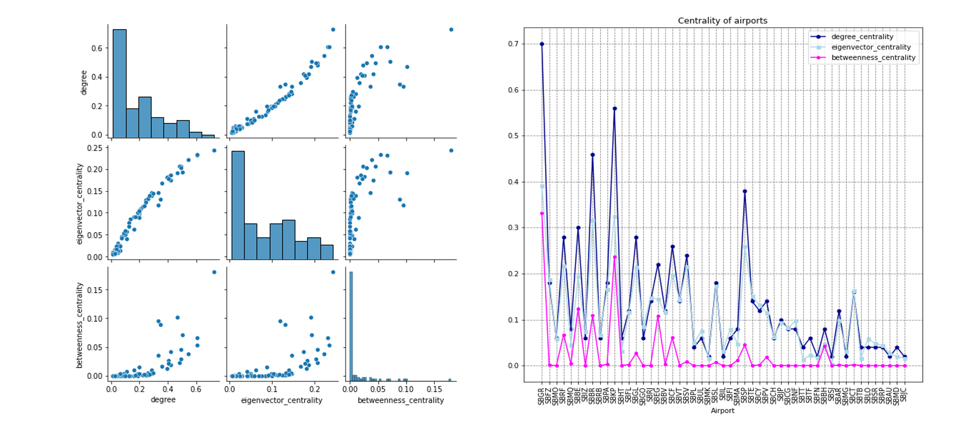
Descriptive statistics
Low betweenness centrality : majority are direct flights, no transfer, hence, shortest length paths are short
Eigenvector centrality distribution : if core-periphery structure exists in the network, periphery nodes will remain to have low scores and core nodes will have relevant high scores

Slide 7
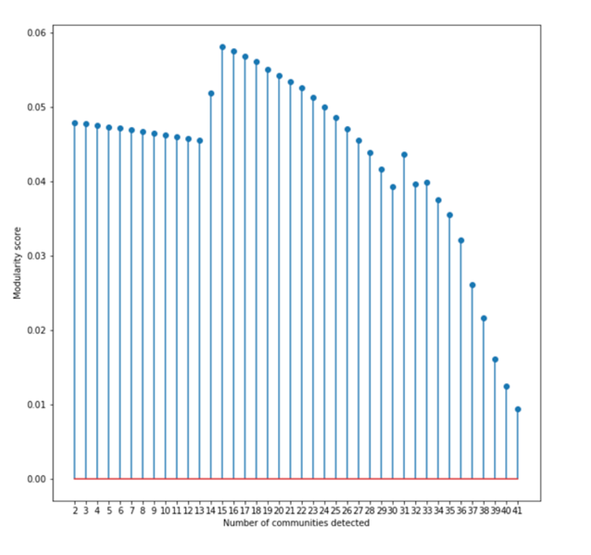
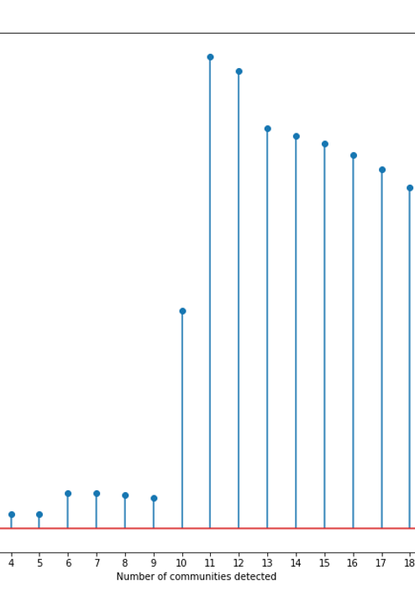
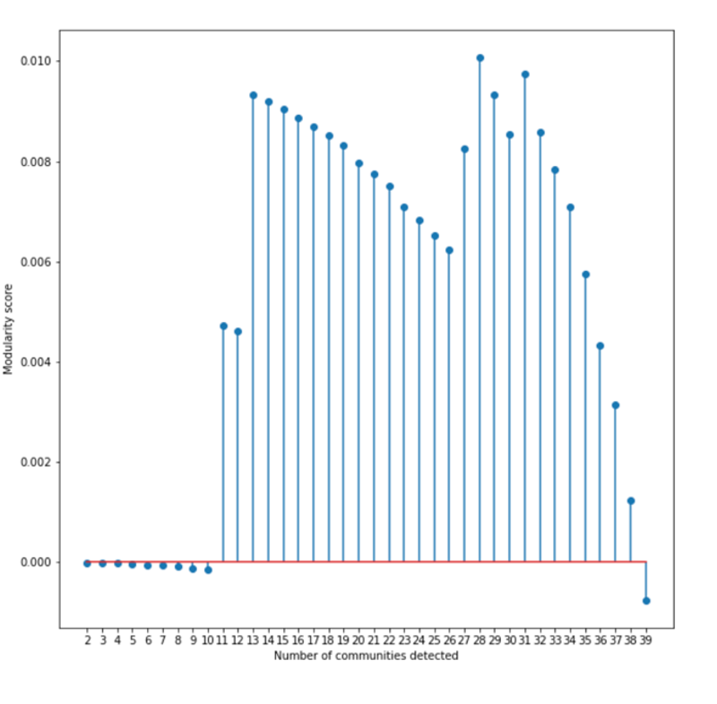
Modularity
Before-Pandemic, Apr to Jun 2019 : peak at 0.01; network has dense connections between the nodes with modules as well as dense connections between nodes in different modules as air travel is not affected
At Pandemic, Apr to Jun 2020 : peak 0.008, lower score The network does not have dense connections between the nodes within modules but sparse connections between nodes in different modules
Post Pandemic, Apr to Jun, 2021 : peak at 0.06, recovery period is seen. Strong connections between within communities and outside communities of the network

Slide 8
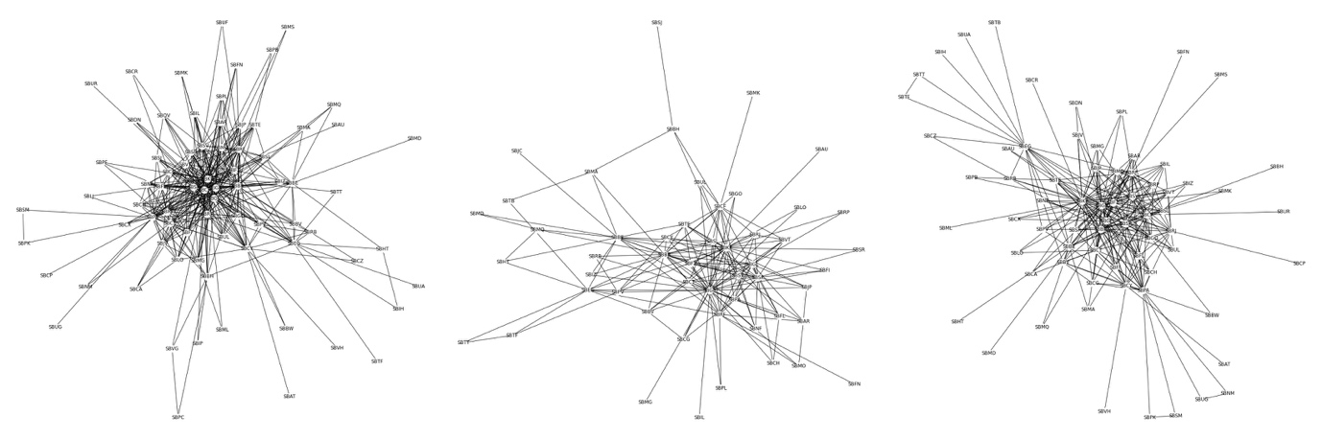
Network Structures

Slide 9
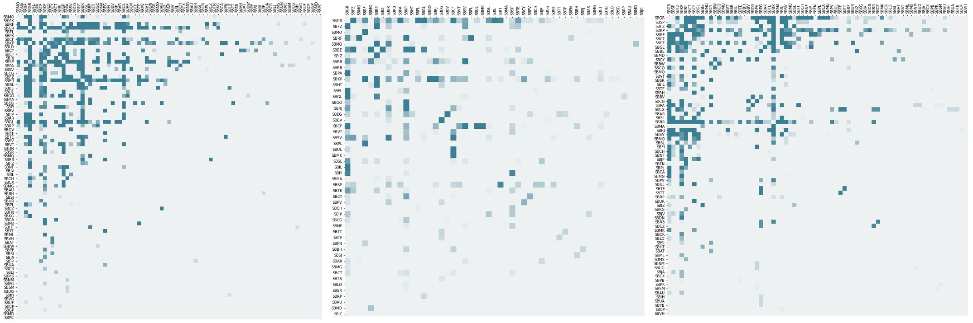
Core-periphery structure and performance changing
Before pandemic, the core nodes are quite strong.
At pandemic, the core-periphery is not so different, this explains why the modularity score is lower and community detection with merely 10.
After pandemic, the network seems to reform another structure with two core

Slide 10
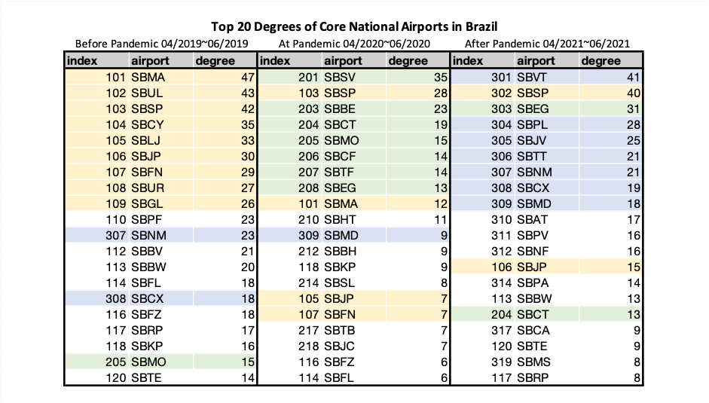
Top 20 Degrees of Core National Airports in Brazil
Airport SBMD is originally from non-core position to climb up to the top 10 of core airports in Brazil.
Airport SBSP remains the same as core airport.
Airport SBEG is firstly outside the top 20 degrees airport but eventually rank at third highest degree airport in Brazil.

Slide 11
Summary
We could easily inspect that especially at Apr 2020 to Jun 2020, total flights, open airports, and flights types decreased with a huge number. At Jul 2020 to Jun 2021 is the recovering period to gradually be back to the original structure in Brazil.
Network of flights in Brazil is scale-free rather than a random one.
Most of the betweenness centrality distribution is with a very low value. This indicates that in Brazil majority of flights are direct flights, and there’s no need to transfer within a lot of different airports. In other words, the shortest length paths are really short.
At the pandemic period shown in the middle plot, we could see the betweenness centrality distribution with a low score is thicker. Theoretically thinking, we believe that some nodes from the periphery were not open during the pandemic period.
At pandemic, modularity score has decreased at nearly 0.008 when compared to the score at pre-pandemic. The network does not have dense connections between the nodes within modules.
Adjacency matrix after pandemic the network seems to reform another structure with two core.
Flights Network in Brazil after covid pandemic has transformed into different hubs based on core-periphery structure.

